Slide 1

Azul Checkpoint #2
Group 5

Slide 2
Fuel Waste Reduction Through Fleet Reassignment Prioritization
An evidence-based project presentation for prioritizing operationally feasible E2 allocation opportunities inside Azul's observed network.
288,107
cleaned flight records
419
origin-destination routes
7
E2-for-E1 route priorities
481k kg
modeled fuel saving
Observed sample period: 2024-01-01 to 2025-11-15. Fuel burn is measured in kg because the source field is TripFuelBurnTotal [KG].
Primary decision: prioritize E2 frames on route groups where E1 and E2 already overlap operationally and the equal-seat screen remains fuel-positive.
Sources: Azul_DataSample.xlsx, Azul_Project_Data_2.xlsx, Main Fleet Analysis.ipynb, azul_seasonal_fleet_assignment_v2.py

Slide 3
EXECUTIVE SUMMARY
Executive Summary: E2-for-E1 is the Clearest Actionable Opportunity
7
candidate routes
641
observed E1 sweet-spot flights
26.8%
median equal-seat fuel saving
481,443
kg over equivalent observed seat supply
Fuel-only screening finds three possible substitution directions, but two weaken after capacity is held constant.
E2 replacing E1 is the only direction that is fuel-positive without requiring additional frequency under the seat-capacity proxy.
The result is a prioritization rule for E2 allocation, not an automatic fleet-assignment decision.
Implementation should proceed through route and rotation validation before schedule changes.
Recommendation: use the seven candidate routes as the first validation queue for incoming E2 allocation.
Sources: Azul_DataSample.xlsx, Azul_Project_Data_2.xlsx, Main Fleet Analysis.ipynb, azul_seasonal_fleet_assignment_v2.py

Slide 4
PROJECT CONTEXT
The Operational Problem is Avoidable Fuel Burn, Not Abstract Efficiency
Azul operates a mixed fleet across regional, medium-haul, and longer narrowbody missions.
Raw fuel consumption is driven by route length, payload, take-off weight, aircraft type, and frequency.
The project objective is to identify reassignment candidates that reduce fuel burn while preserving operational feasibility.
The analysis treats fuel waste as avoidable kg of fuel under a feasible alternative aircraft assignment.
Decision metric
Fuel saved (kg) is always scoped to a denominator: per observed flight, per route-month, or over equivalent observed seat supply.
The result identifies candidate opportunities. It does not replace Azul's crew, maintenance, airport, and rotation planning systems.
The project narrows a broad fuel-efficiency question into specific route and route-month decisions.
Sources: Azul_DataSample.xlsx, Azul_Project_Data_2.xlsx, Main Fleet Analysis.ipynb, azul_seasonal_fleet_assignment_v2.py

Slide 5
DATA FOUNDATION
The Evidence Base Combines Flight Operations With Load Proxies
Source | File | Scope | Use in analysis
Operational flights | Azul_DataSample.xlsx | 288,337 raw rows | fuel kg, TOW kg, time sec, distance NM, route, aircraft
Load evidence | Azul_Project_Data_2.xlsx | route / flight / equipment averages | passengers per flight proxy, payload kg, cargo, baggage
Analysis sample | v2 cleaned outputs | 288,107 rows; 230 removed | filters remove invalid denominators and implausible speeds
113
airports in sample
419
routes
90.46%
exact load join share
99.92%
records retained
Data preparation is intentionally light-touch: only records with invalid or implausible efficiency denominators are removed.
Sources: Azul_DataSample.xlsx, Azul_Project_Data_2.xlsx, Main Fleet Analysis.ipynb, azul_seasonal_fleet_assignment_v2.py

Slide 6
ANALYTICAL APPROACH
The Analysis Uses a Decision Funnel to Avoid False Comparisons
1. Fleet profile
2. Operating envelopes
3. Overlap screen
Understand mission bands and aircraft roles
Define TOW and sweet-spot conditions by aircraft
Compare only routes where multiple aircraft appear in sweet spots
4. Capacity screen
5. Seasonal engine
6. Operational validation
Hold approximate seat supply constant
Translate structural route evidence into route-month review targets
Check rotations, crew, airport, maintenance, and economics
The funnel is designed to move from broad operational data to a short list of implementable candidates.
Sources: Azul_DataSample.xlsx, Azul_Project_Data_2.xlsx, Main Fleet Analysis.ipynb, azul_seasonal_fleet_assignment_v2.py

Slide 7
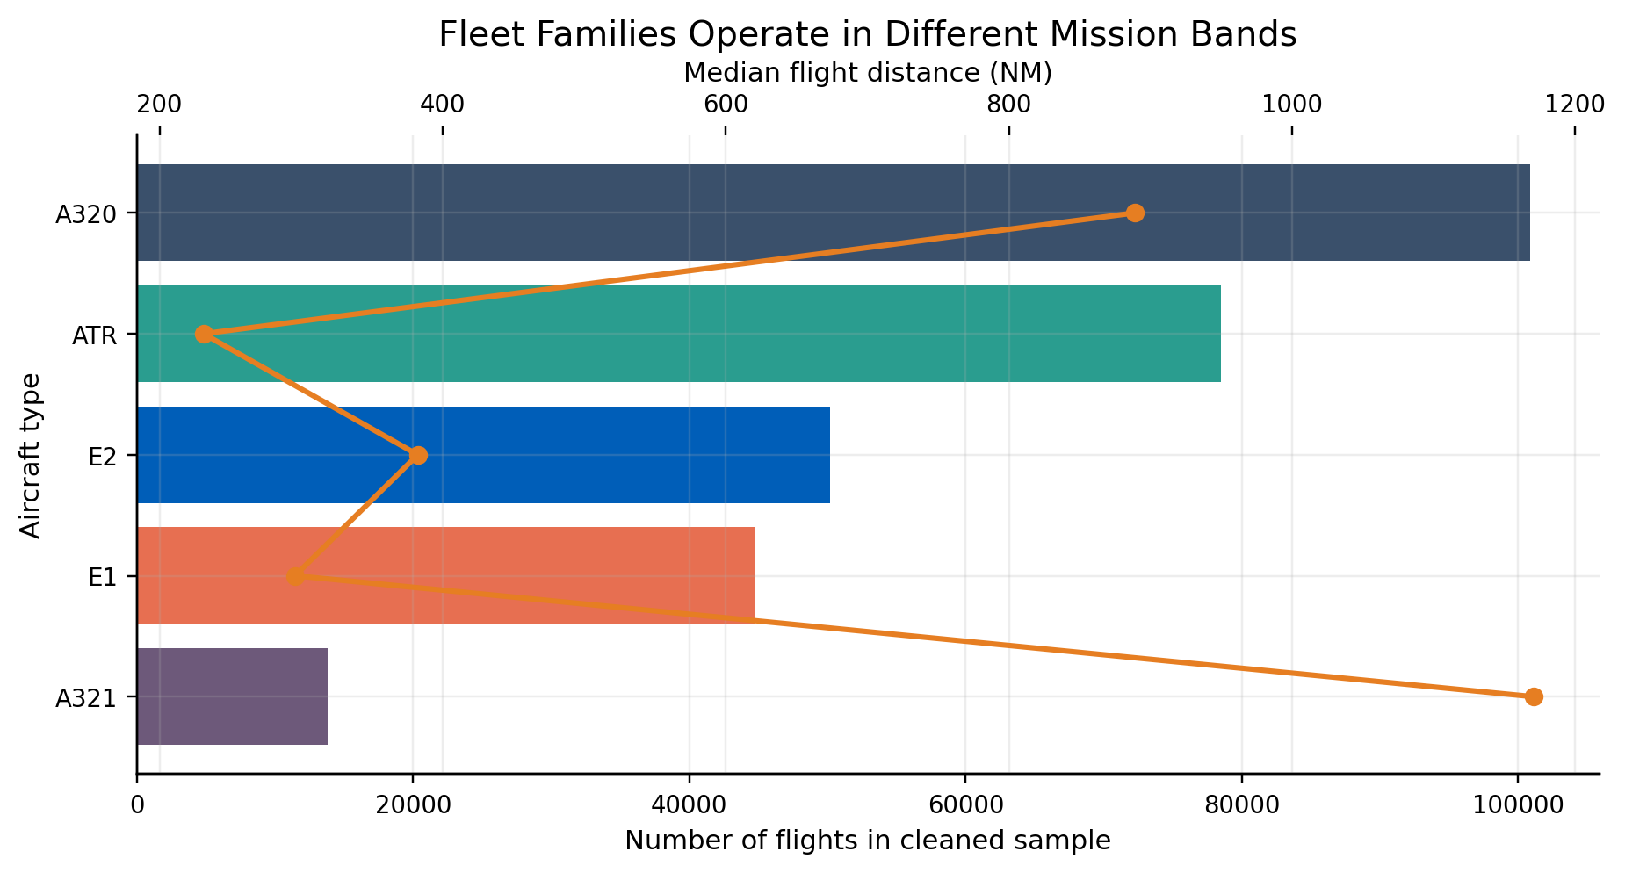
FLEET PROFILE
Fleet Families Operate in Different Mission Bands
Aircraft | Flights | Median distance (NM) | Median TOW (kg) | Median fuel (kg/NM)
ATR | 78,452 | 231.0 | 21,225 | 2.96
E1 | 44,805 | 295.6 | 44,429 | 6.67
E2 | 50,191 | 382.4 | 52,745 | 4.98
A320 | 100,865 | 889.2 | 66,644 | 5.38
A321 | 13,794 | 1,170.4 | 80,116 | 6.01
Direct cross-fleet fuel comparisons would overstate differences caused by mission length and aircraft role.
Operational comparability is required before ranking aircraft by fuel burn.
Sources: Azul_DataSample.xlsx, Azul_Project_Data_2.xlsx, Main Fleet Analysis.ipynb, azul_seasonal_fleet_assignment_v2.py

Slide 8
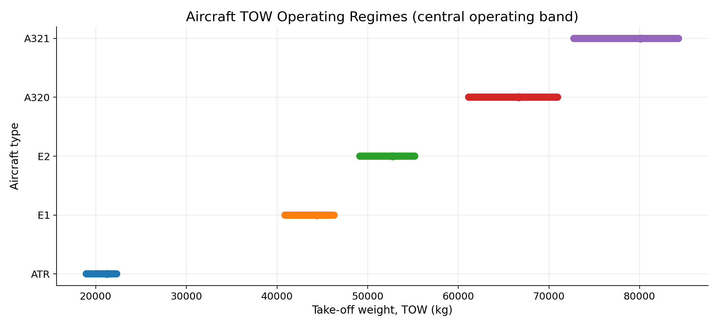
OPERATING ENVELOPES
Operating Envelopes Define the Comparable Space
Aircraft | Flights | Low TOW (kg) | Median TOW (kg) | High TOW (kg)
ATR | 78,452 | 18,948 | 21,225 | 22,305
E1 | 44,805 | 40,868 | 44,429 | 46,299
E2 | 50,191 | 49,129 | 52,745 | 55,191
A320 | 100,865 | 61,142 | 66,644 | 70,963
A321 | 13,794 | 72,751 | 80,116 | 84,299
TOW regimes are inferred from central observed operations and help classify whether a route-month behaves like a lighter or heavier aircraft assignment.
TOW is used as an operational proxy for aircraft size, payload, and mission assignment behavior.
Sources: Azul_DataSample.xlsx, Azul_Project_Data_2.xlsx, Main Fleet Analysis.ipynb, azul_seasonal_fleet_assignment_v2.py

Slide 9
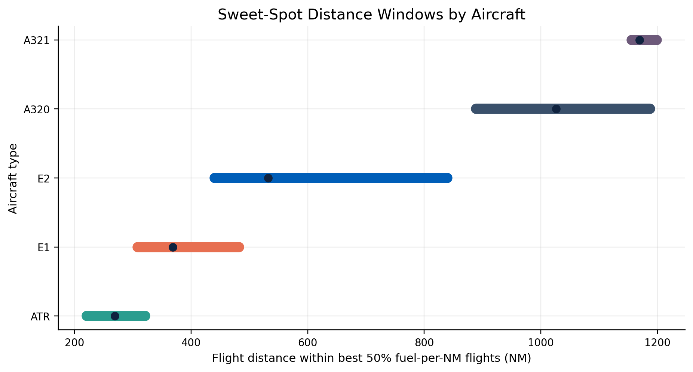
SWEET SPOT METHODOLOGY
Sweet Spots Measure Where Each Aircraft Performs Best
Rank each aircraft family's flights by kg/NM.
Use the best-performing 50% to define the aircraft's observed efficient operating conditions.
Calculate IQR windows for distance, trip time, and TOW.
A joint sweet-spot flight must fall inside all three windows.
Quartiles do not assume a linear fuel curve; they define the central observed region of efficient operations.
This creates a fairer comparison space before route-level substitution is tested.
Sources: Azul_DataSample.xlsx, Azul_Project_Data_2.xlsx, Main Fleet Analysis.ipynb, azul_seasonal_fleet_assignment_v2.py

Slide 10
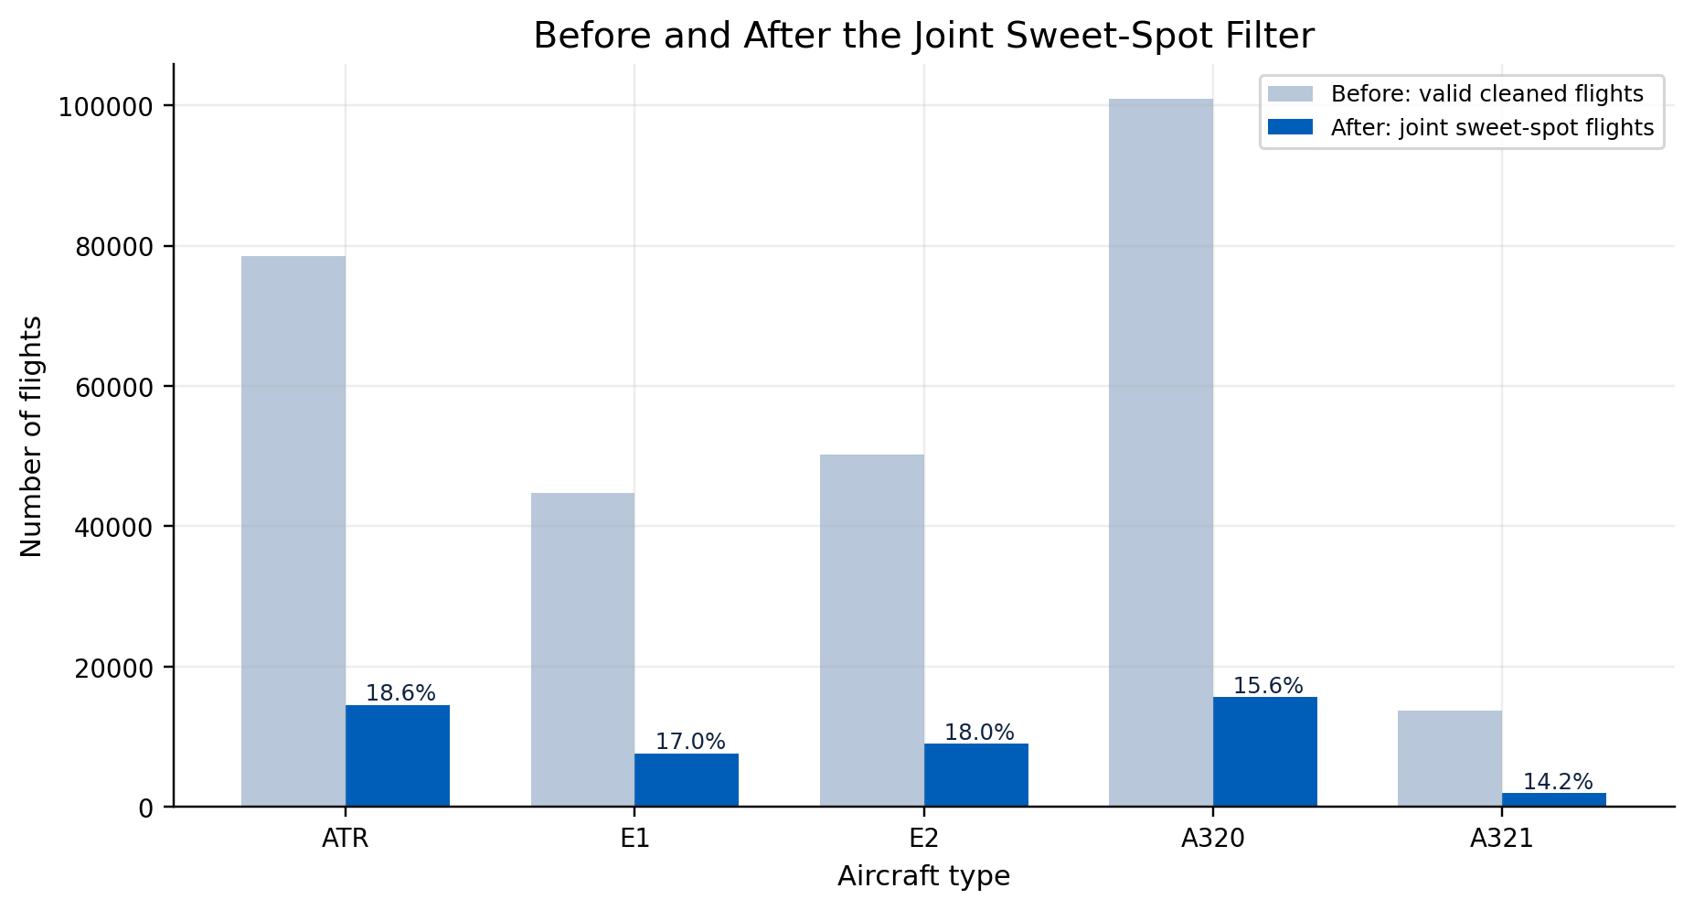
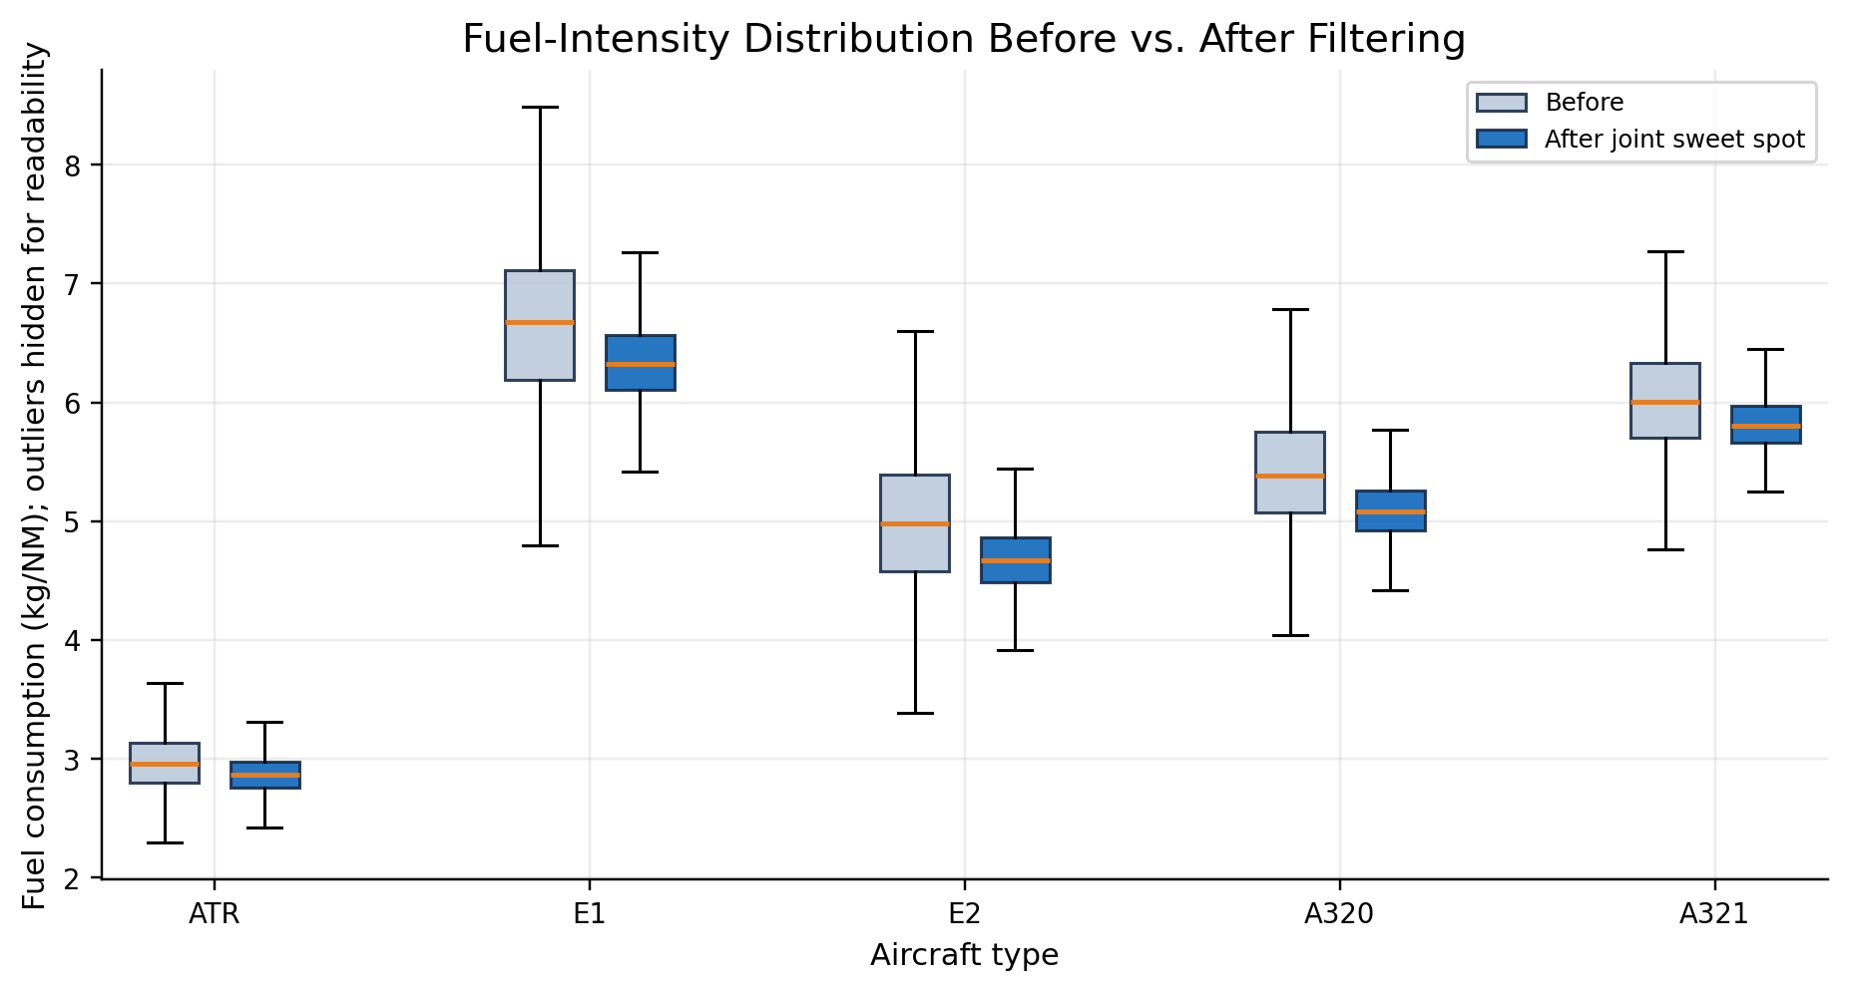
BEFORE / AFTER FILTER
Joint Sweet-Spot Filtering Creates a Comparable Operating Sample
Nonlinear aircraft behavior makes global linear comparisons risky, while quartiles provide a robust, model-free way to compare the central operating range of each aircraft's efficient flights.
The filter removes tail behavior and mission-mix noise before any substitution candidates are ranked.
Sources: Azul_DataSample.xlsx, Azul_Project_Data_2.xlsx, Main Fleet Analysis.ipynb, azul_seasonal_fleet_assignment_v2.py

Slide 11
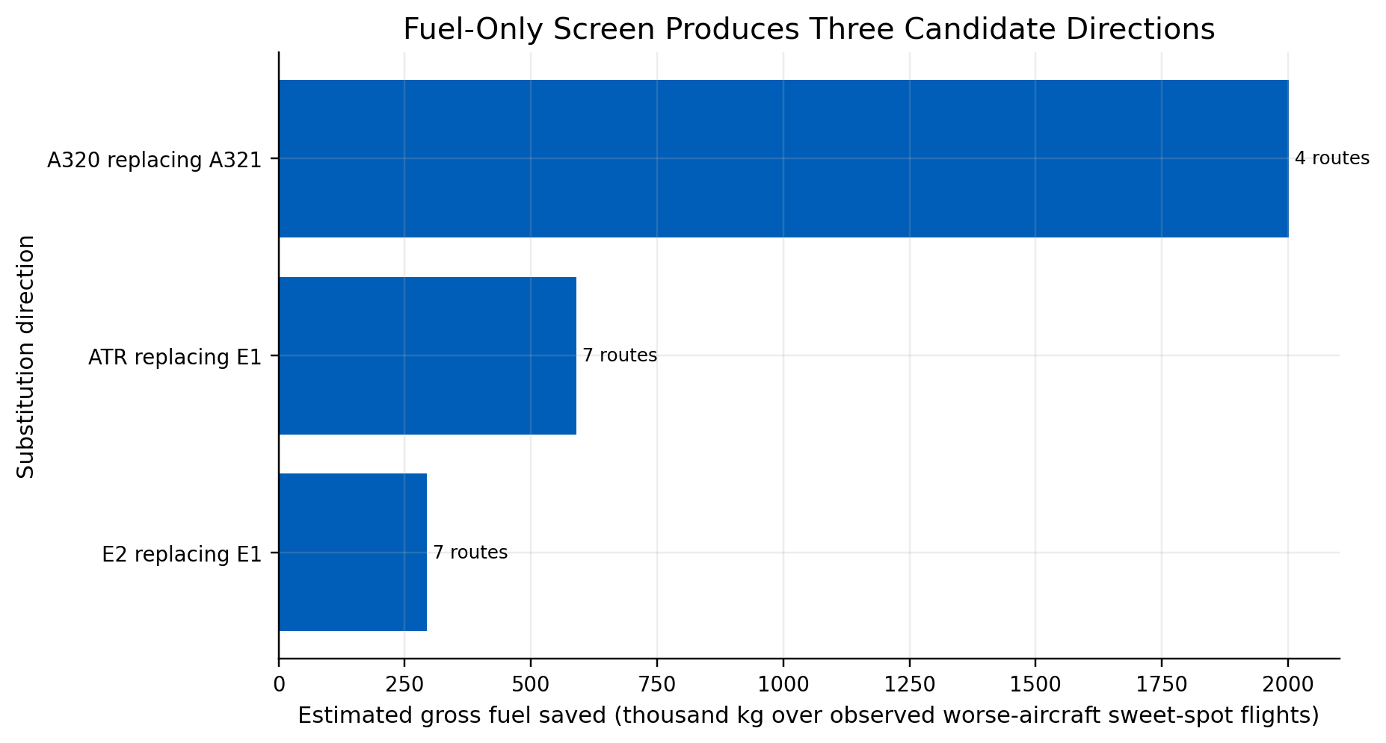
OPPORTUNITY SCREEN
Fuel-Only Screening Finds Three Possible Swap Directions
Fuel-only direction | Routes | Worse-aircraft flights | Median kg/NM saving
A320 replacing A321 | 4 | 1957 | 14.6%
ATR replacing E1 | 7 | 459 | 57.5%
E2 replacing E1 | 7 | 641 | 17.7%
Fuel-only savings are not enough: a smaller aircraft may require more frequencies to maintain seat supply.
The next screen tests whether each candidate still works when approximate seat capacity is preserved.
Sources: Azul_DataSample.xlsx, Azul_Project_Data_2.xlsx, Main Fleet Analysis.ipynb, azul_seasonal_fleet_assignment_v2.py

Slide 12
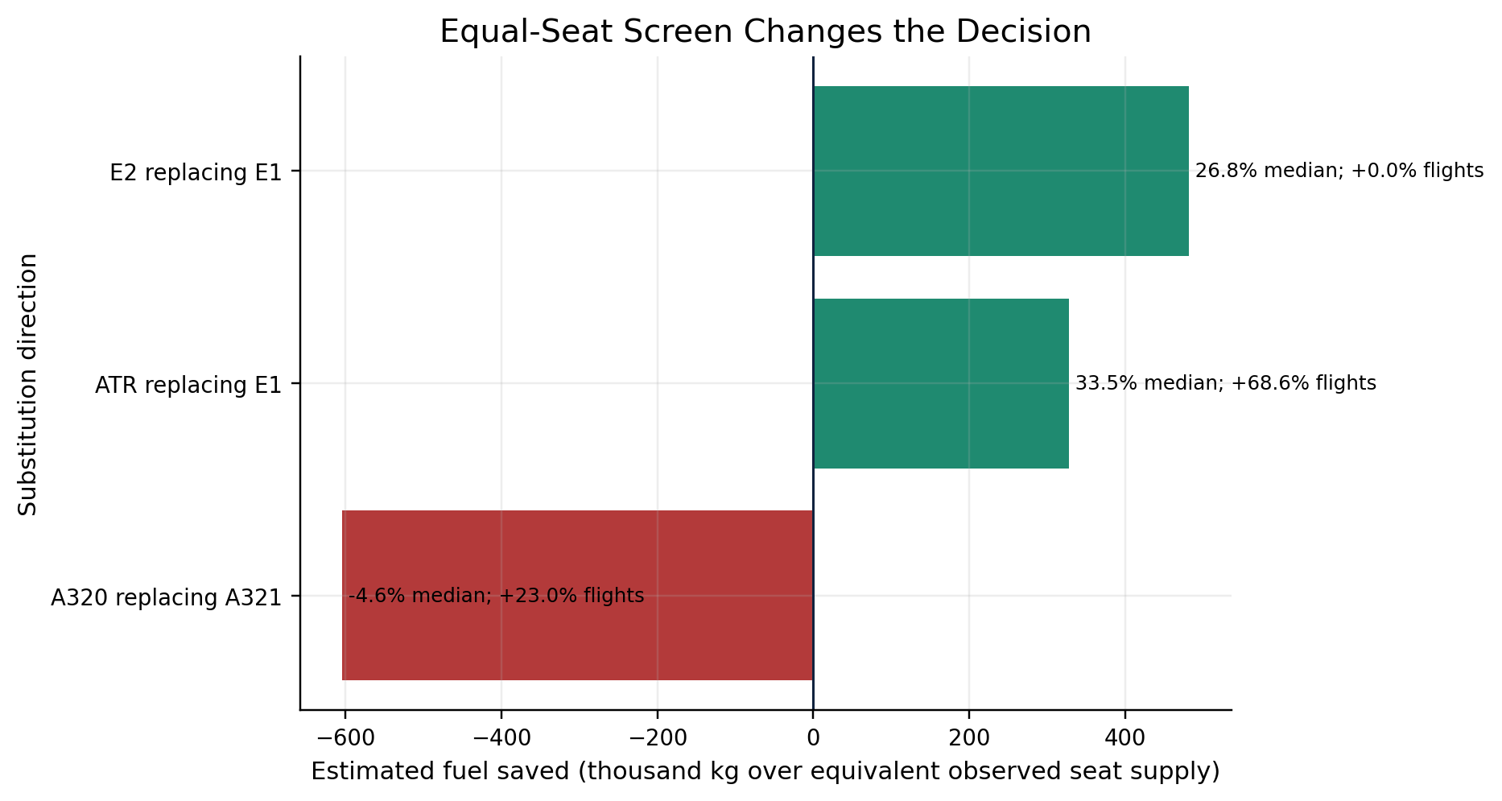
DECISION SCREEN
The Capacity Screen Makes E2-for-E1 the Strongest Candidate
Substitution | Routes | Median extra flights | Median equal-seat saving
E2 replacing E1 | 7 | 0.0% | 26.8%
ATR replacing E1 | 7 | 68.6% | 33.5%
A320 replacing A321 | 4 | 23.0% | -4.6%
Aircraft | Seat proxy
ATR | 70
E1 | 118
E2 | 136
A320 | 174
A321 | 214
Seat values are fixed aircraft-family assumptions, not load-factor estimates.
E2-for-E1 remains fuel-positive without extra frequency because the assumed E2 seat count exceeds E1. A320-for-A321 turns negative; ATR-for-E1 requires 68.6% more flights.
E2 replacing E1 is the only direction that passes both the fuel and equal-seat-supply screens without extra flights.
Sources: Azul_DataSample.xlsx, Azul_Project_Data_2.xlsx, Main Fleet Analysis.ipynb, azul_seasonal_fleet_assignment_v2.py

Slide 13
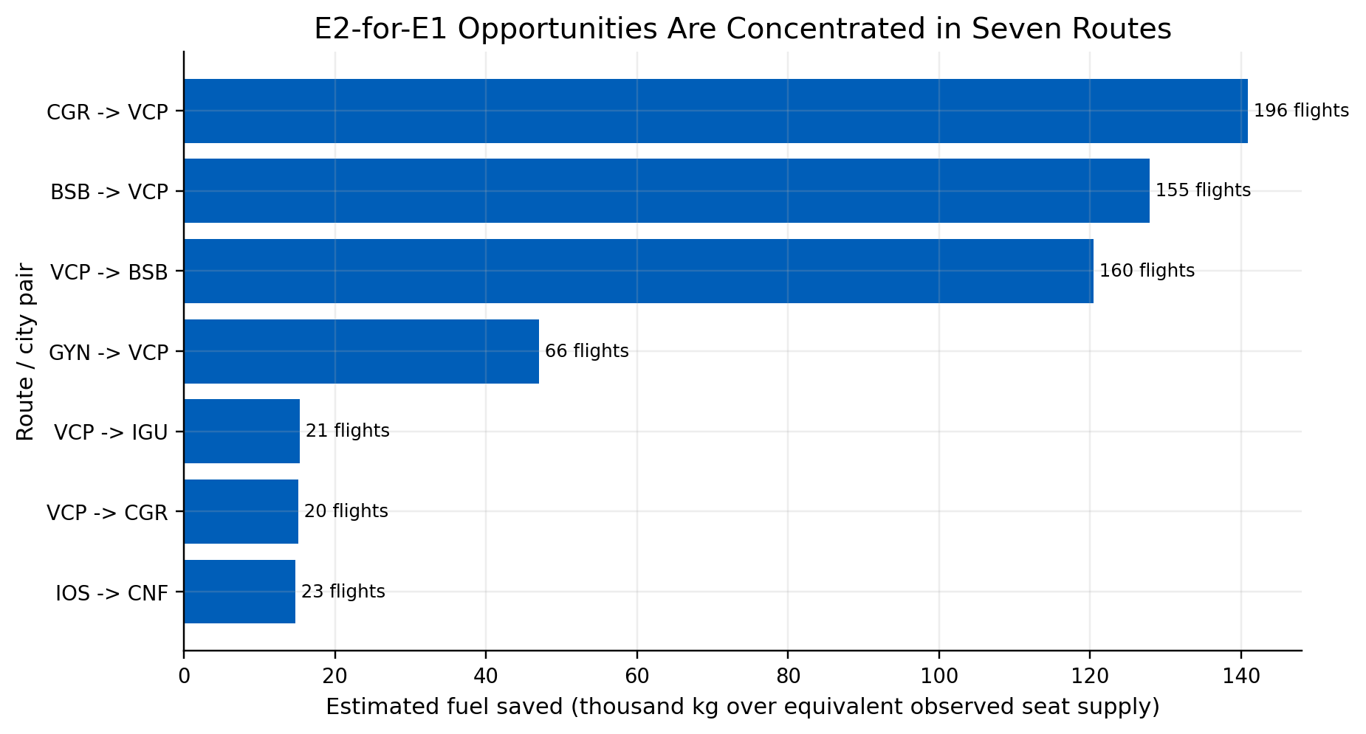
ROUTE PRIORITIES
Seven Routes Form the Initial E2-for-E1 Validation Queue
7
routes
641
E1 sweet flights
26.8%
median saving
751
kg per observed E1 flight equivalent
Total modeled saving: 481,443 kg over equivalent observed seat supply. This value is not annualized and does not represent total network fuel.
Use these routes as a prioritized engineering and scheduling review list.
Sources: Azul_DataSample.xlsx, Azul_Project_Data_2.xlsx, Main Fleet Analysis.ipynb, azul_seasonal_fleet_assignment_v2.py

Slide 14
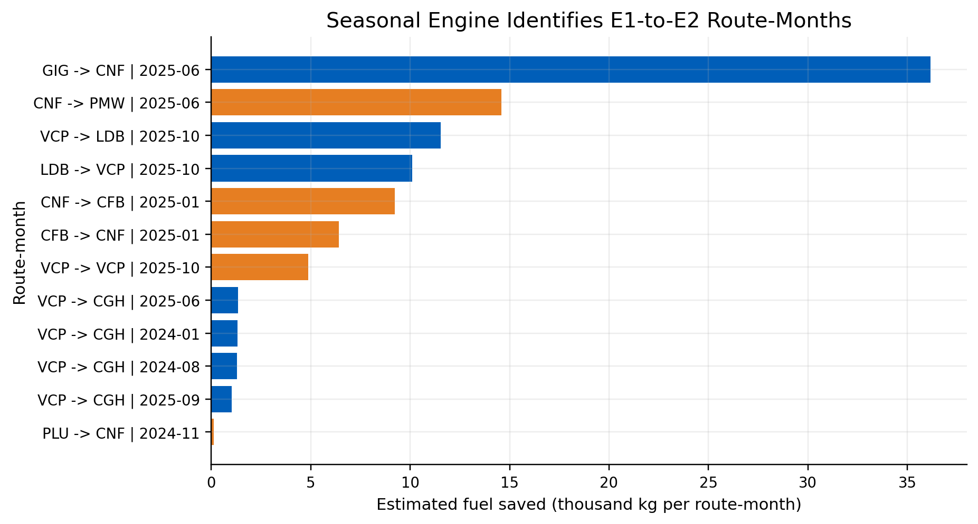
ROUTE-MONTH PRIORITIES
The Seasonal Engine Translates Route Evidence Into Timing Signals
12
E1-to-E2 route-months
98k kg
sum of kg per route-month
Route-months are compared with each route's own median behavior.
E1-to-E2 flags require E1 primary aircraft, seasonal load/frequency signal, and observed E2 kg/NM advantage.
The metric is kg saved per route-month, separate from the equal-seat sweet-spot estimate.
Seasonal outputs are scheduling review targets, not automatic assignment instructions.
Sources: Azul_DataSample.xlsx, Azul_Project_Data_2.xlsx, Main Fleet Analysis.ipynb, azul_seasonal_fleet_assignment_v2.py

Slide 15
OPERATIONAL INTERPRETATION
Operational Implication: Treat the Output as a Ranked Validation List
Layer | Operational meaning
Supported decision | Prioritize E2 allocation where E1 and E2 overlap and the equal-seat fuel screen is positive.
Implementation use | Create a route and route-month review queue for schedule planning and fleet assignment teams.
What remains open | Tail rotations, crew currency, maintenance checks, gates, slots, payload restrictions, and economics.
Measurement plan | Track kg per flight and kg/NM before/after candidate reassignment against comparable control routes.
The analysis does not argue for broad replacement of E1 with E2; it prioritizes where the next available E2 is expected to produce the largest fuel benefit.
Route-level evidence should be validated inside the actual rotations that operate each candidate segment.
The output is decision support for Azul teams, not a standalone optimizer.
Sources: Azul_DataSample.xlsx, Azul_Project_Data_2.xlsx, Main Fleet Analysis.ipynb, azul_seasonal_fleet_assignment_v2.py

Slide 16
RECOMMENDATIONS
Recommended Implementation Path
Phase | Action | Decision output
1. Validate | Review seven E2-for-E1 routes against rotations, airport compatibility, crew, and maintenance constraints. | Confirmed pilot set
2. Pilot | Assign E2 capacity to validated corridors where schedule integrity and seat supply are preserved. | Measured fuel impact
3. Institutionalize | Run the seasonal route-month screen before schedule planning cycles. | Repeatable allocation rule
4. Expand | Add demand, fare, cost, and tail-level constraints to move from screening to optimization. | Constrained assignment model
Immediate recommendation: start with the seven E2-for-E1 candidate routes and validate feasibility before broadening the scope.
The next decision is not whether E2 is generally better; it is where E2 allocation should be prioritized first.
Sources: Azul_DataSample.xlsx, Azul_Project_Data_2.xlsx, Main Fleet Analysis.ipynb, azul_seasonal_fleet_assignment_v2.py

Slide 17
LIMITATIONS AND NEXT STEPS
Constraints and Next Steps for Azul Validation
Validation area | Next analytical step
Demand and revenue | Replace seat proxy with real seats by tail/subfleet, bookings, load factor, spill, and revenue data.
Operations | Check tail rotations, crew availability, maintenance timing, turn times, and hub connectivity.
Airport feasibility | Validate gates, ramp handling, slots, runway limits, and payload restrictions station-by-station.
Economics | Convert gross fuel saving into net contribution with lease, maintenance reserve, crew, and delay costs.
Pilot measurement | Use before/after kg per flight and kg/NM tracking against comparable controls.
The central result is robust as a fuel-prioritization rule, but final implementation requires Azul-internal constraint data.
Next project phase: constrained implementation model seeded by the E2-for-E1 opportunities identified here.
Sources: Azul_DataSample.xlsx, Azul_Project_Data_2.xlsx, Main Fleet Analysis.ipynb, azul_seasonal_fleet_assignment_v2.py

